Slide 1
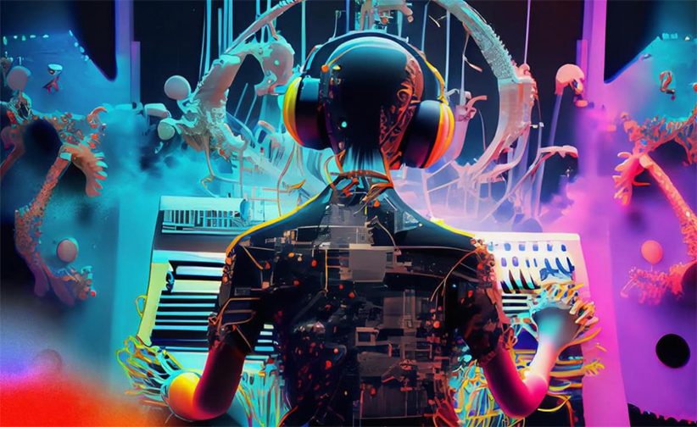
MUSE - Machine enhanced User Sound Experience
Shivam Arora, Aman Soni, Zubair Qazi, Sidharth
Image taken from https://ampedstudio.com/ai-in-music/
Department of CSE, University of Michigan, Ann Arbor

Slide 2
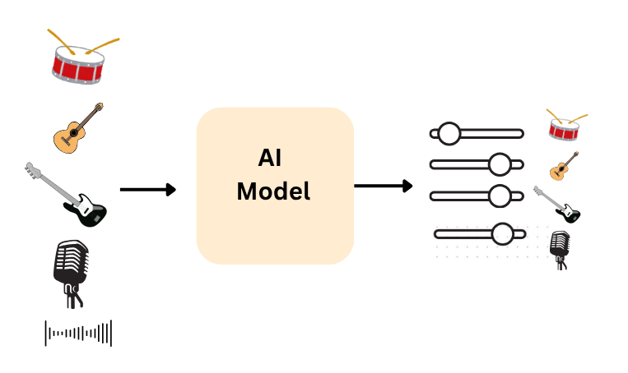
Recap
Design a personalized AI music mixing software to personalize music to users

Slide 3
Problem Statement
Domain: Audio HAI
Current music apps rely on fixed equalizers and static presets, with little personalization.
Different listeners, different needs: neurodivergent users may be sensitive to noise, accessibility users may need clarity, and others want context-based mixes (workout vs studying).
No system today learns and adapts in real time to a person’s preferred way of hearing music.

Slide 4
Research Questions
1. How do people currently use or edit audio, if they do at all?
2. How familiar are users with audio editing or mixing tools?
3. Which interface design feels easiest or most natural to use?
4. What kinds of controls or feedback do users want in an audio tool?
5. How do users think they would use a tool like MUSE?
6. In what situations would people find MUSE most helpful?

Slide 5

Methods
The study used an interview-based method.
Three participants were interviewed in person, one-on-one
Supplemental data from online participants
  Collected via Google Forms, stored in Google sheets

Slide 6
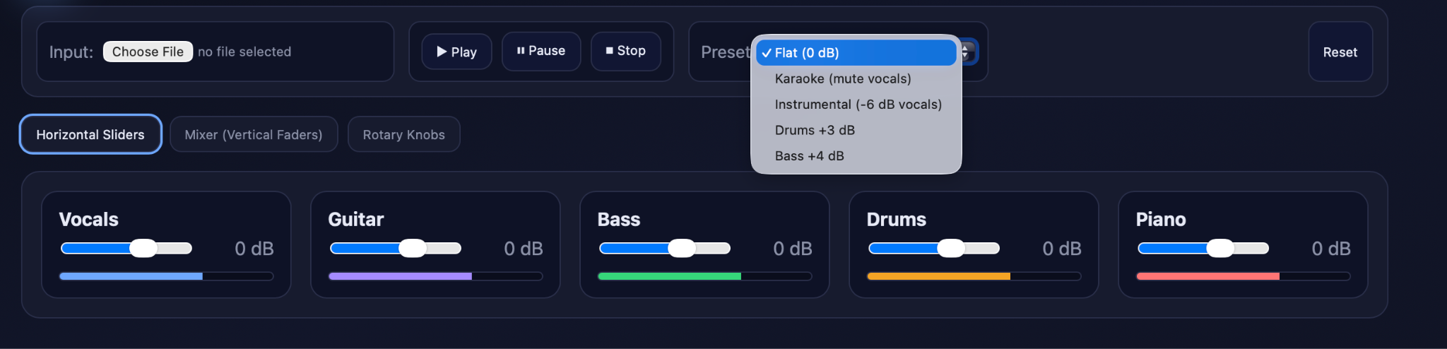
Design Choices
Wireframe 1 (Horizontal Slider)

Slide 7
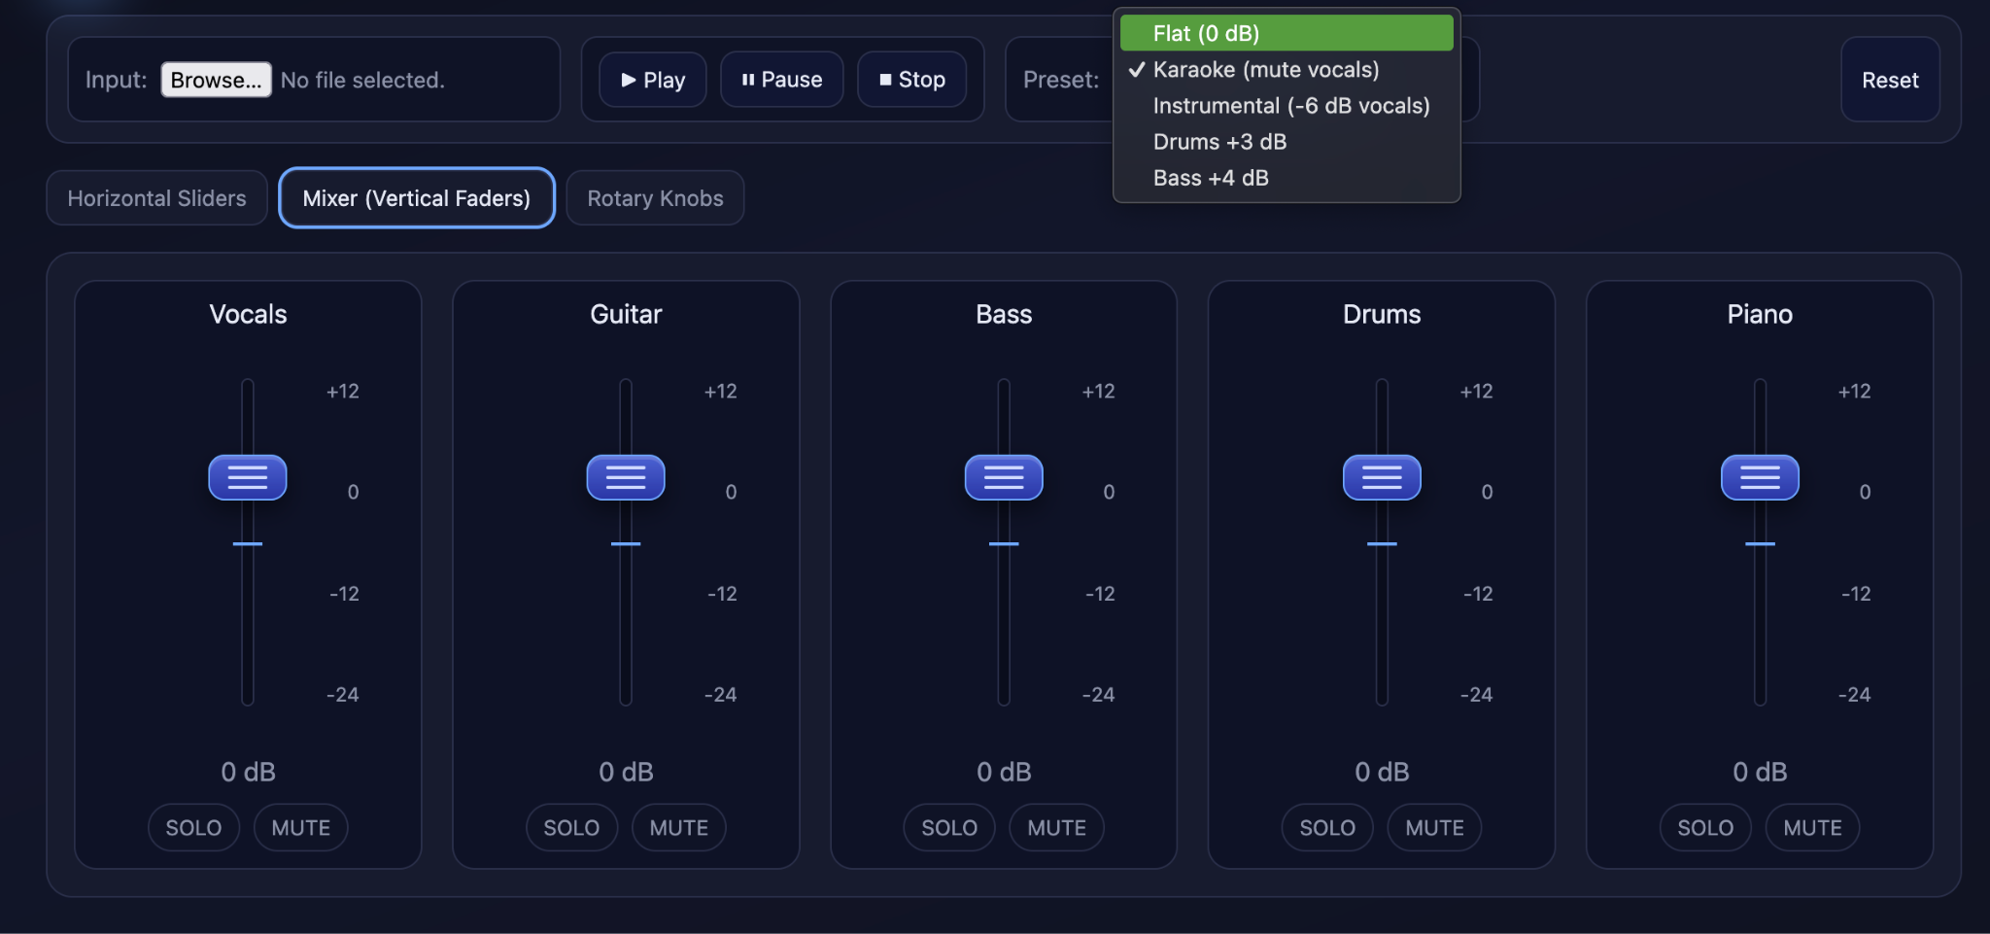
Design Choices
Wireframe 2 (Vertical Slider)

Slide 8
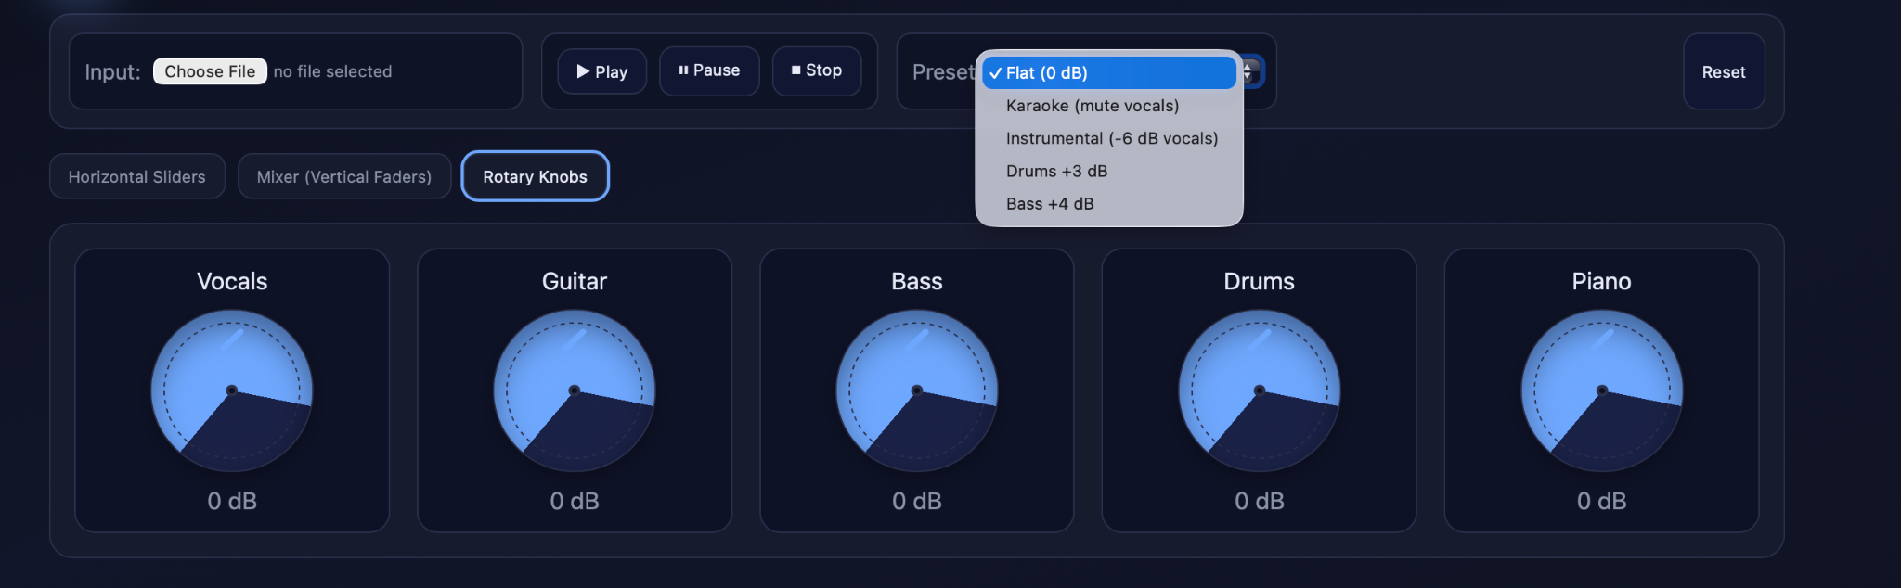
Design Choices
Wireframe 3 (Knobs)

Slide 9
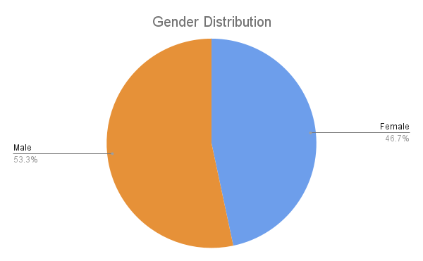
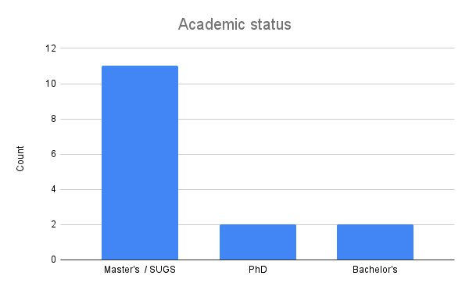
Findings
Participants and Background
  Most participants were Master’s-level students; two PhD and two Bachelor’s participants also took part.
  Equal gender distribution; most reported no hearing impairments.

Slide 10
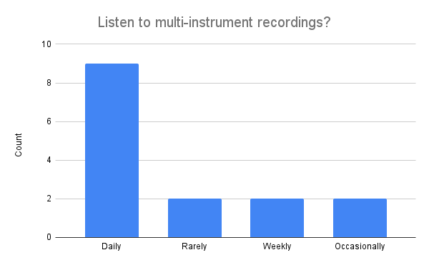
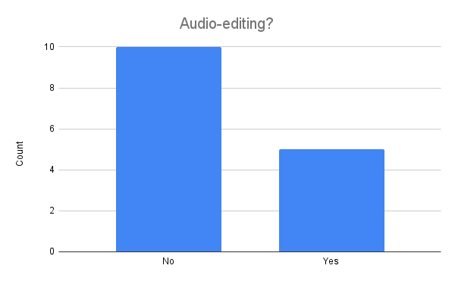
Findings (cont.)
Audio Experience
  Almost all participants listen to multi-instrument audio daily (mainly music).
  Few had prior experience with audio editing tools; only a few mentioned using Audacity or GarageBand.
  Engagement with audio is primarily consumptive rather than creative.

Slide 11
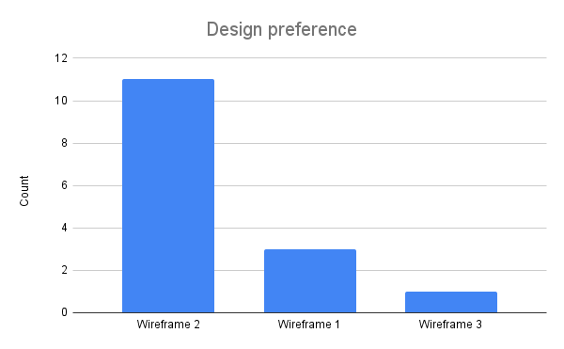
Findings (cont.)
Interface Preference
  Vertical sliders (Wireframe 2) were strongly preferred for their familiarity and perceived precision.
    Strong association to professional software like GarageBand or physical hardware.
  Knob and horizontal slider layouts were viewed as less intuitive or harder to control.

Slide 12
Findings (cont.)
Usability and Design Feedback
  Simplicity and clarity were valued over advanced functionality.
  Participants appreciated straightforward features like volume, mute, and audio upload.
  Visual feedback (e.g., real-time level indicators or waveforms) was repeatedly mentioned as important.
  Many wanted the interface to “feel responsive” and provide visible confirmation of changes.

Slide 13
Findings (cont.)
Perceived Use Cases
  Common examples included boosting lecture recordings, creating karaoke tracks, and improving audiobook clarity.
  Participants saw MUSE as a lightweight enhancement tool rather than a full professional editor.

Slide 14

Design Implications
Use vertical sliders as the default control scheme.
Maintain a clean, minimal layout with strong visual feedback.
Prioritize ease of entry for casual users; advanced features can be optional.

Slide 15

Functional Requirements
Upload audio files (e.g., MP3, WAV) from the user’s device
Separate audio into components — vocals, instrumentals, background layers
Adjust individual track levels through the chosen interface (sliders, knobs, etc.)
Provide real-time preview of adjustments before exporting
Save the setting for future use

Slide 16
UX Requirements
The interface should be simple and intuitive for users with little or no audio-editing experience.
Provide immediate visual and auditory feedback when adjustments are made.
Enable smooth, low-latency interaction for real-time control.
Maintain a clean, uncluttered layout that highlights main controls.
Support users with different hearing or visual needs through clear visuals and contrast options.

